Slide 1
Pass the ball

Slide 2
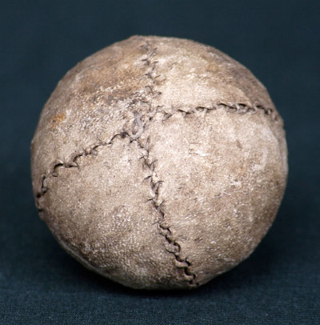
Pass the ball

Slide 3

start

