Slide 1
Guinness book
BY alice

Slide 2
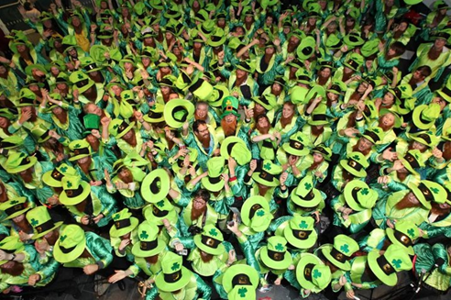
Top 5
Dublin, Ireland - The largest
gathering of
people dressed as leprechauns
was 262 leprechauns who
gathering at Canal Theatre,
Dublin as part of
The Mooney Show on RTE1.

Slide 3
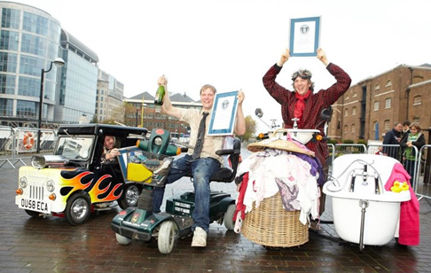
Top 4
London, UK - The eccentric
men behind such contraptions
as the fastest toilet, smallest
roadworthy car, and fastest
mobility scooter faced off
in their first ever race!

Slide 4
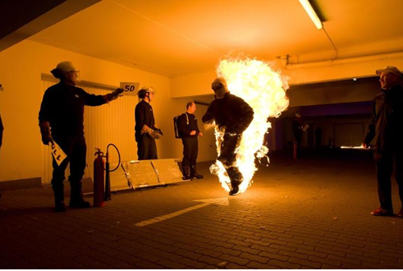
Top 3
Hamburg, Germany -
The longest distance ran
full-body burn
(without oxygen)
is 120 m (393 ft 8.4 in)
and was achieved by
Denni Düsterhöft (Germany).

Slide 5
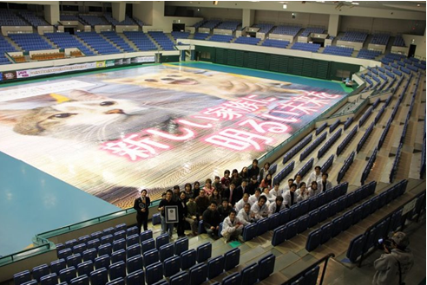
Top 2
Nagoya, Japan -
The largest photo mosaic
measuring 1,562.39 m²
( 16,817.30 ft²) and
containing 137,200
individual photographs
was achieved by
Smile-one Taichi Matsumoto.

Slide 6
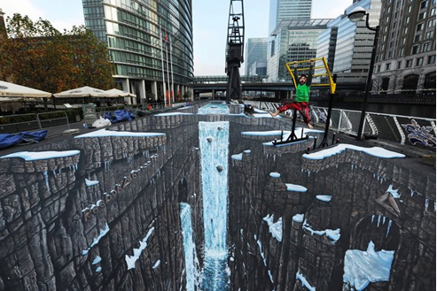
Top 1!
London, UK –
Joe Hill of 3D Joe and Max
created a piece that was
both the largest (1160.45m²)
AND longest (106.5m) 3D
painting the world has
ever seen!

Slide 7
Bye~!

