Slide 1
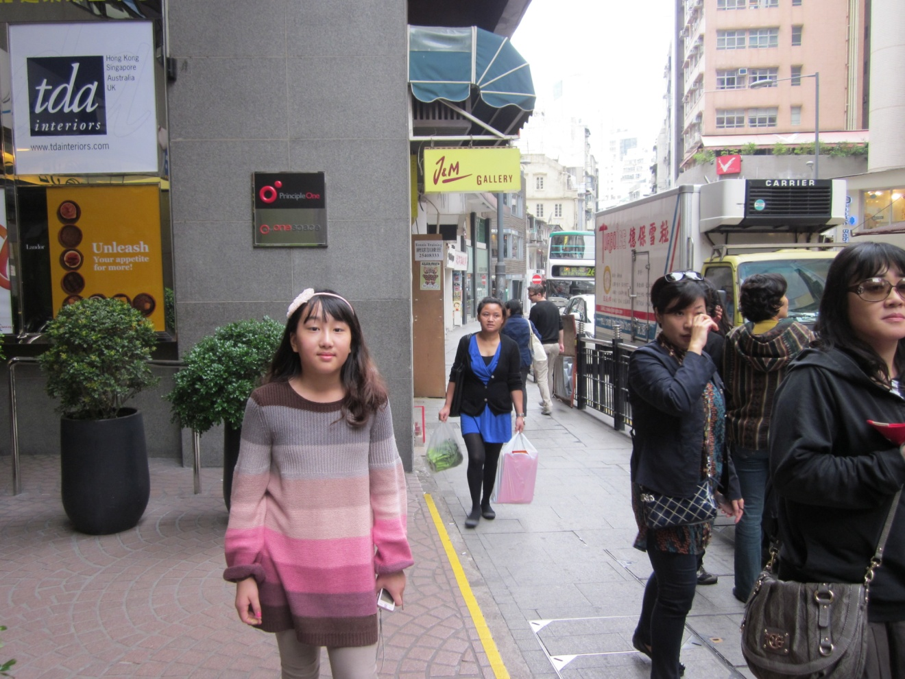
Travel to HongKong

