Slide 1
SHOW&TELL
Kim Song Eun

Slide 2
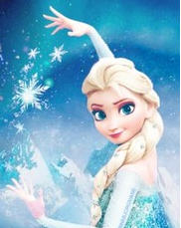
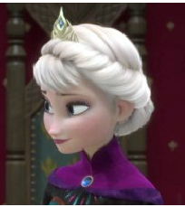
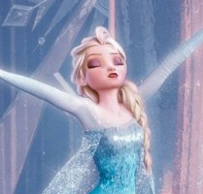
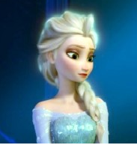
Who would you like to be?
Elsa
Elsa is the character in movie frozen. Elsa has the magic to freeze everything.

Slide 3
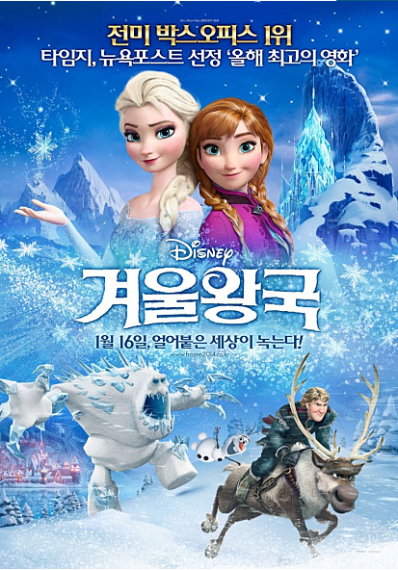
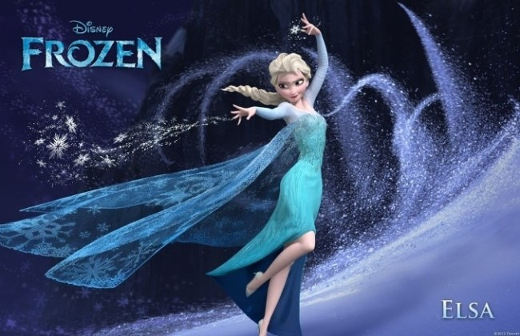
Why would you like to be
this person?
Because I want to have the magic of Elsa.
And movie frozen is very fun.

Slide 4
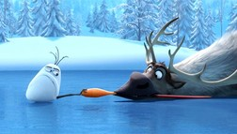
What are you would do if you become
this person?
First,
I make ​​my living room to the ice skating rink.

Slide 5
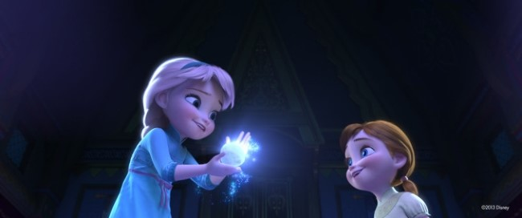
Second,
Using magic to play with my brother.

Slide 6


Third,
I will make ice slide from home to school and I would go to school to ride the slide.

Slide 7
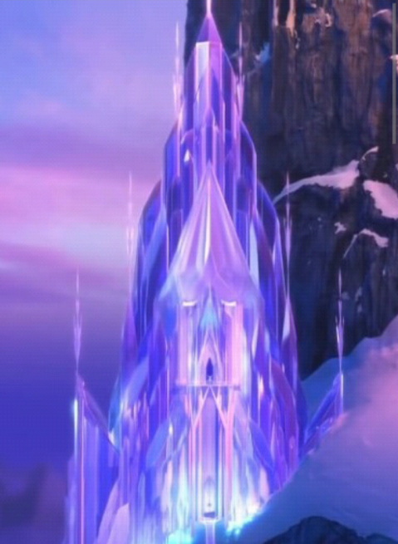
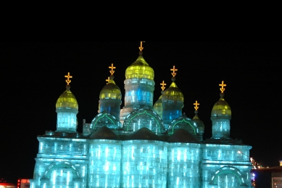
Fourth,
I will make ice amusement park and I want to play there everyone.

Slide 8
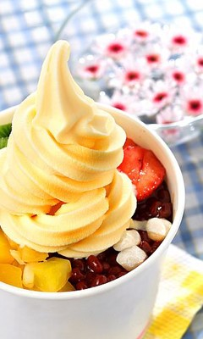
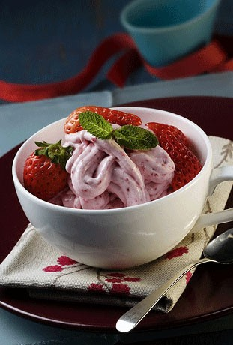
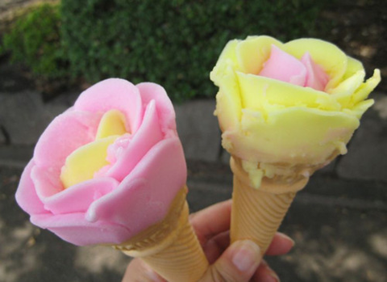
Fifth,
I will make many ice cream.

Slide 9
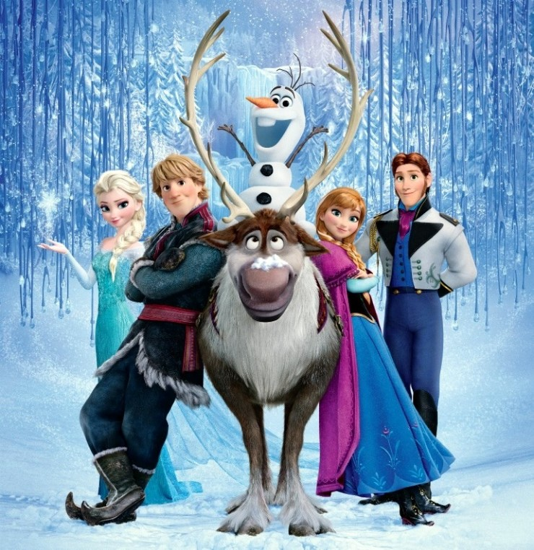
Thank you

